Slide 1
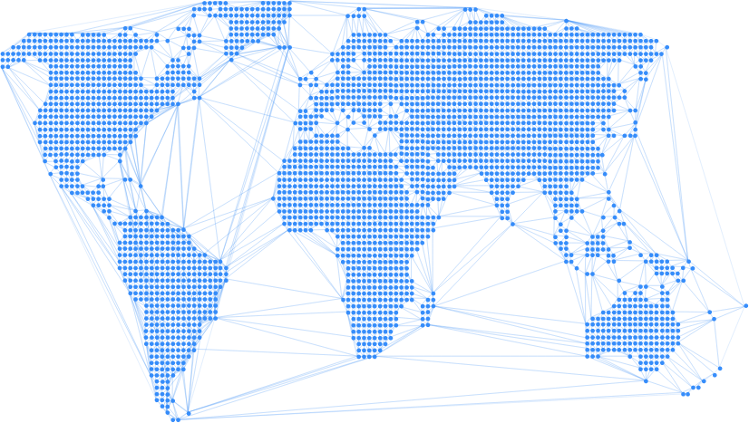

Enable
Creating opportunity through peer-to-peer stablecoin loans

Slide 2
Our Team

Slide 3
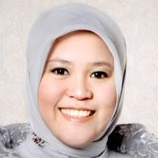
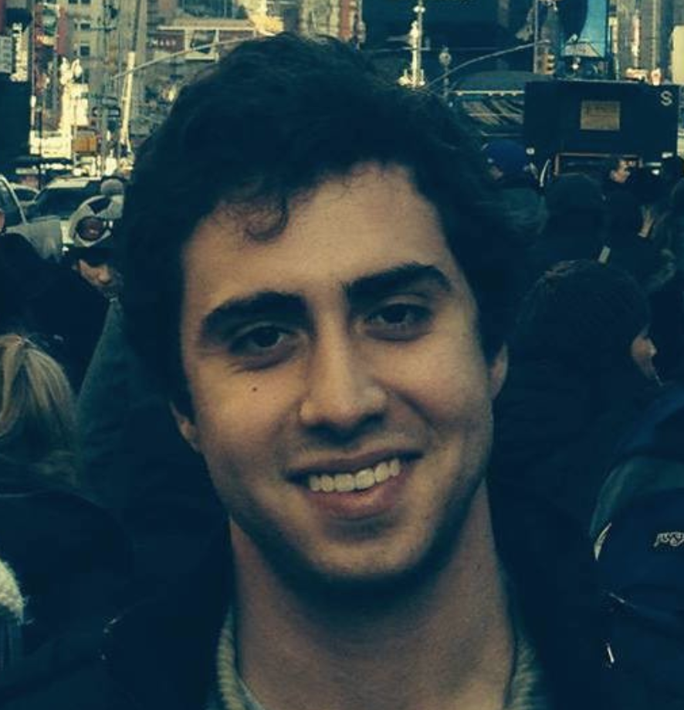
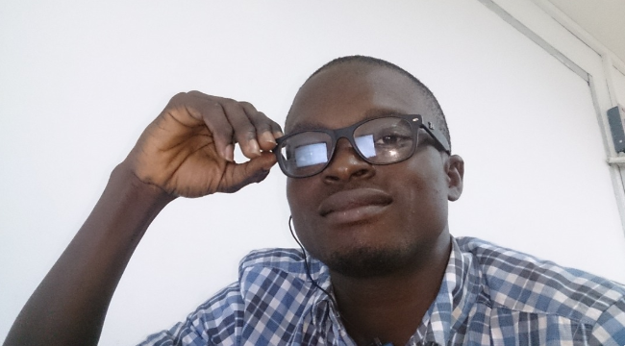
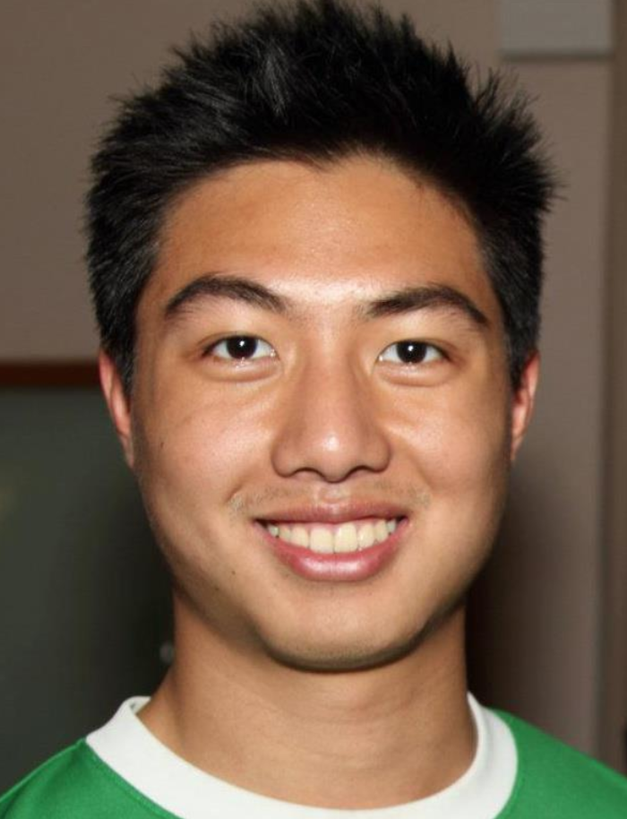

Ines
User
Thomas
Engineer
Daniel
Faisal
Anthony
Engineer
Engineer
Engineer

Slide 4
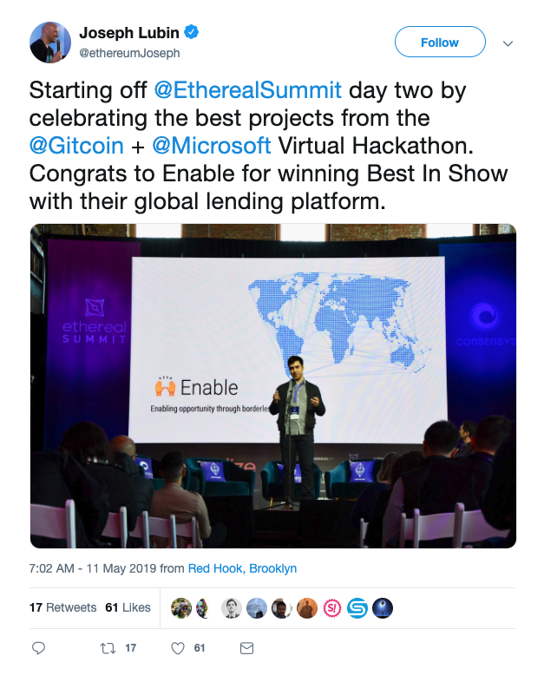
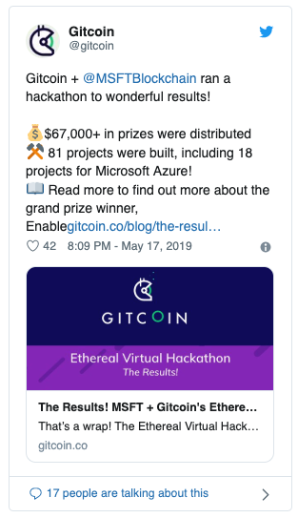
How we started

Slide 5
What we’re building

Slide 6
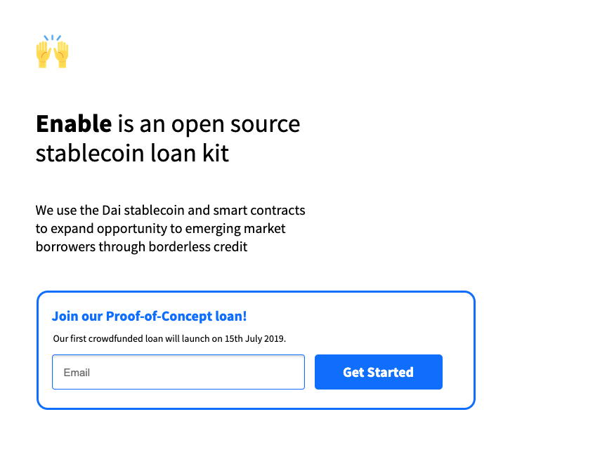

Slide 7
Vision:
On 1st Jan 2020, the Enable loan kit will allow a tech-savvy small business in Nigeria to raise and pay back a Dai loan to 721 lenders from around the world, with 0 middleman cost.
Dai Peer-to-peer Crowdfunding
Dai Loan Contract
Fractional Loan Ownership
“Loan Manager” and tracking

Slide 8
Open Source P2P Stablecoin Loan Kit
Open Source dApp
Records loan terms, tracks repayments and defaults
Handles fractional debt ownership and routing of fractional repayments
Open Source Contracts
Dai Loan Contract
Dai Crowdfund Contract
Fractional Loan Ownership Manager
Manages loan state
Manages fractional ownership of loan

Slide 9
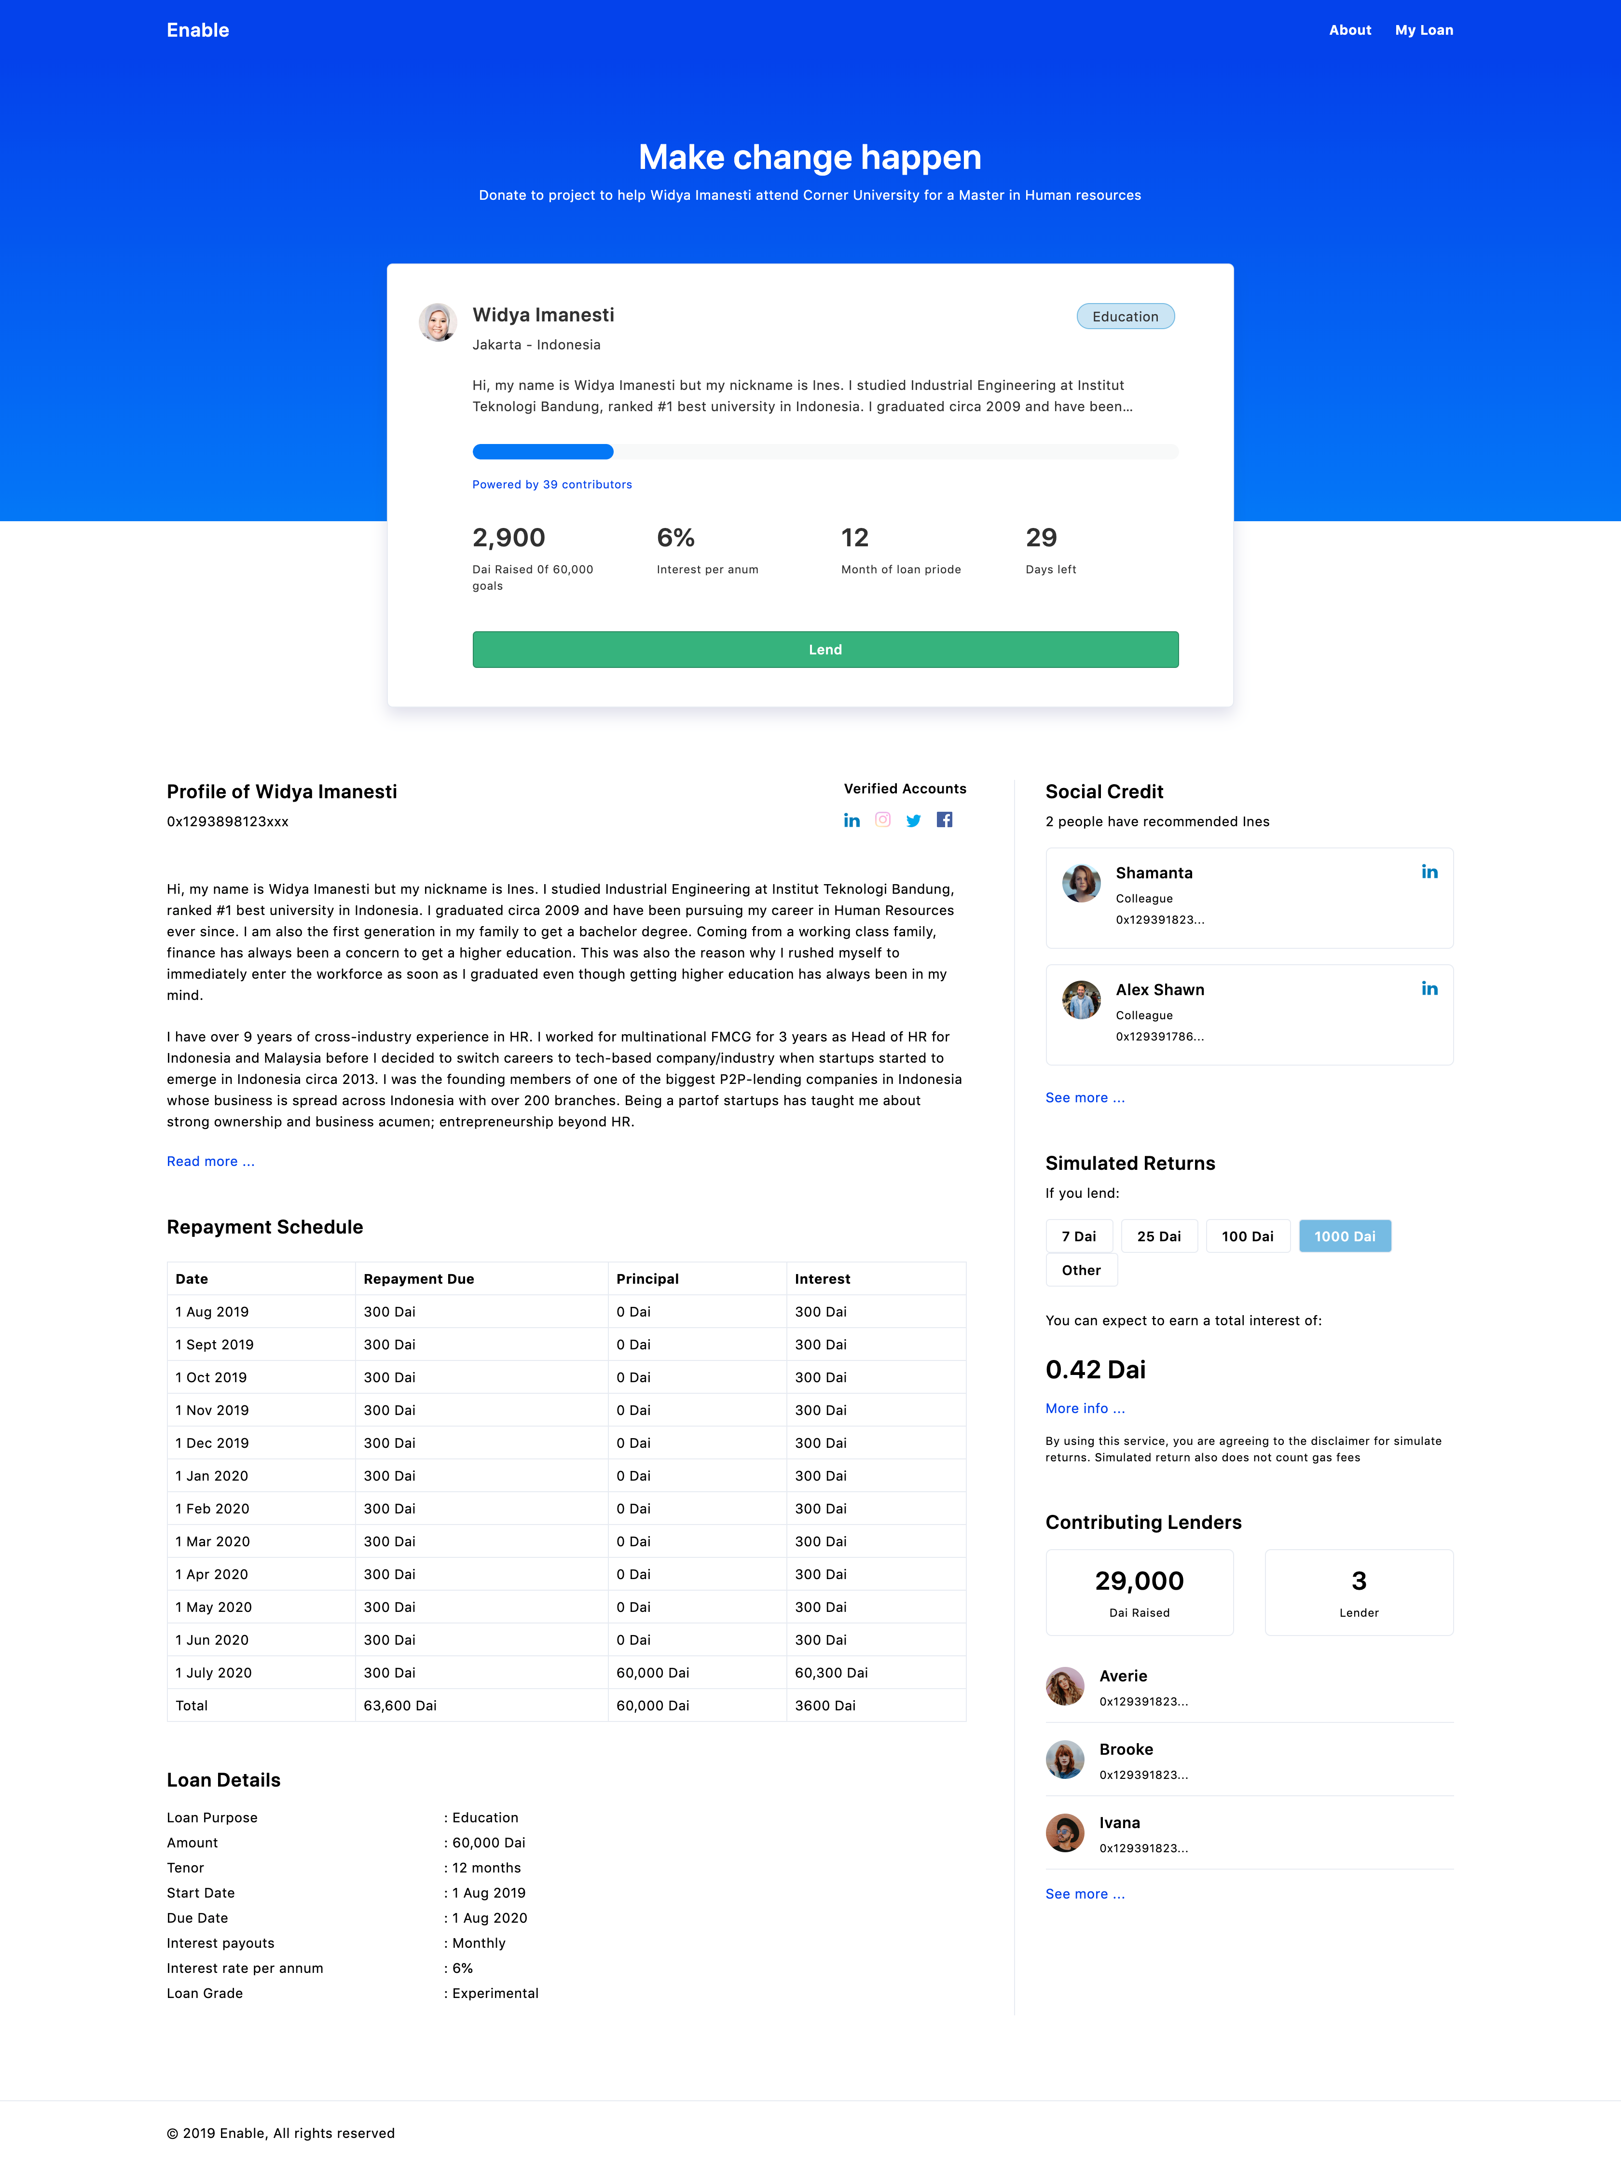
Open Source P2P Stablecoin Loan Kit
Open Source dApp
Crowdfunding Page
Funding Process Flow
Repayment Cycle Tracking
Open Source Contracts
Dai Loan Contract
Dai Crowdfund Contract
Fractional Loan Ownership Manager
Manages loan state
Manages fractional ownership of loan

Slide 10
How it works

Slide 11
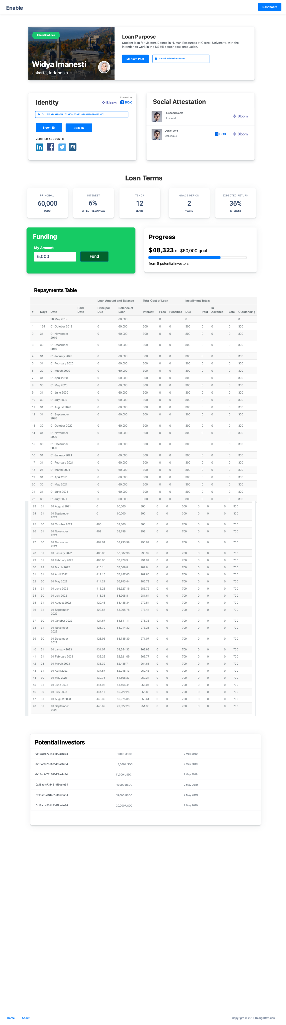



Funding flow
Dai Crowdfund Contract
Contribution
Fractional Ownership Debt Token
Returns Debt Token
Lender
Disburses money to borrower
Borrower
Dai Loan Contract

Slide 12
Repayment Flow
Dai Crowdfund Contract
Receive fractional share of repayment
Repayment routed to debt token holders
Monthly Repayment
Lender
Borrower
Dai Loan Contract

Slide 13
Our first use case

Slide 14
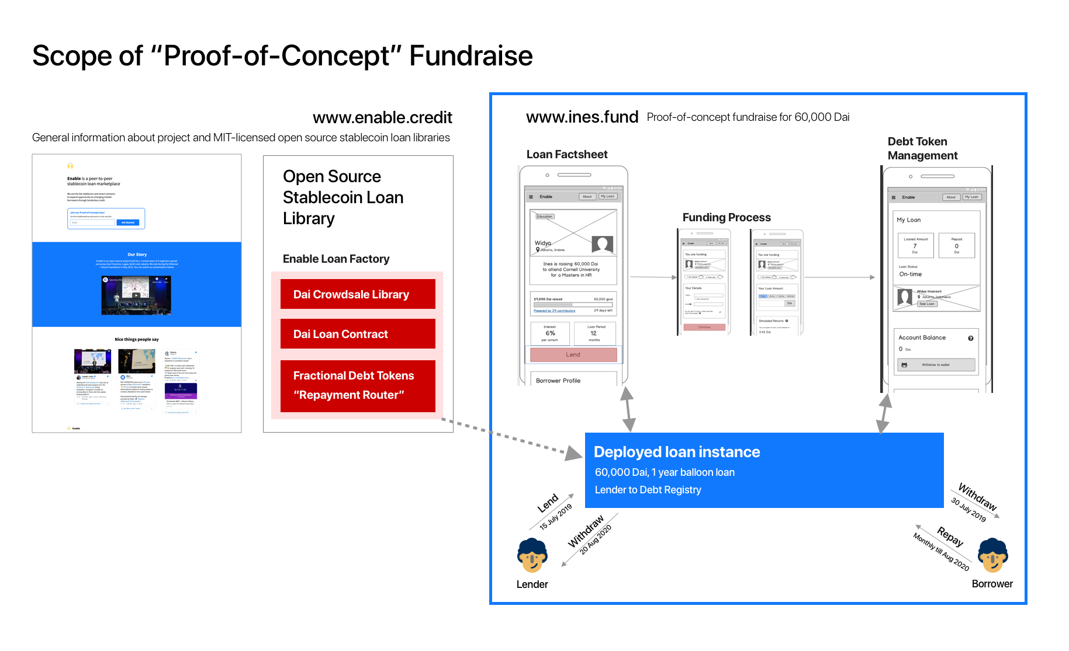

Slide 15
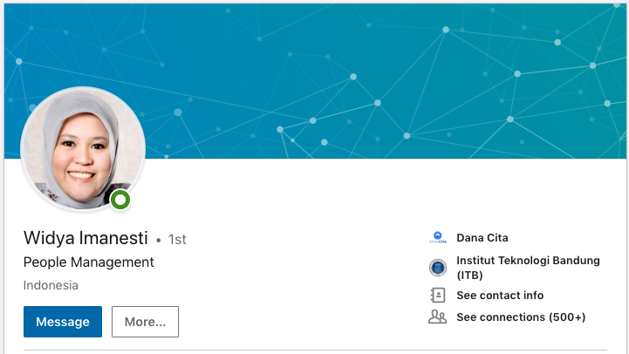
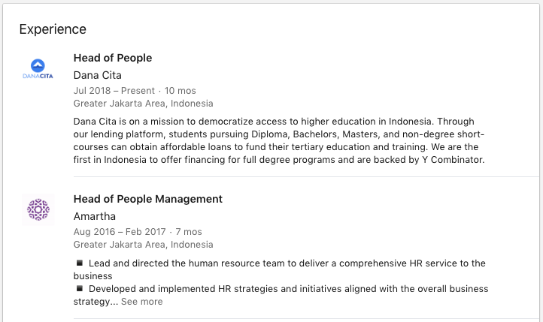
Ines’ Story
Background Executive in Indonesia (Head of HR), with credit history in Indonesia
Family Husband is also from Indonesia, currently doing a PhD in the US
New York Cornell University, Masters in HR US$60,000 due on May 20th

Slide 16
Ines’ Story
$60,000 due May 20th Cornell University, Masters in HR
High domestic interest rates Secured: 9.9% - 12.5%
Unsecured: 17% - 30+%
Inflation: 2.5-2.57%
Indonesia
No access to capital No low-interest rate federal student loan programs, private and state-owned banks only tend to give out small loans (<$3,000) and don’t fund $60,000 loans over 10 years unless it’s a mortgage or commercial loan
Lender’s Fees Traditional lenders charge origination fees (3-5% of loan amount) on top of interest to cover their operations. For a $60,000 loan, that’s $3,000.

Slide 17
Ines’ Story
$60,000 due May 20th Cornell University, Masters in HR
Cost of sending money to the US Domestic bank fees and US bank fees can amount up to 5% or more. For a $60,000 loan, that’s $3,000
Indonesia

Slide 18


Ines’ Story
$60,000 due May 20th Cornell University, Masters in HR
Immigrants have no credit history Credit score and financial reputation in Indonesia doesn’t follow Ines to the US, despite being an executive in Indonesia
Indonesia
Current Solution:
Cross-border lenders (Mpower, Prodigy)
11.99% p.a. interest for $60,000, 10 year loan term (total: $103+k)
5% origination fee (i.e. $3,000)
Only funds $25,000 out of $60,000

Slide 19
Live Fundraise: 15th July 2019 60,000 Dai at 6% interest for 1 year

Slide 20
Why we benefit the Dai ecosystem

Slide 21
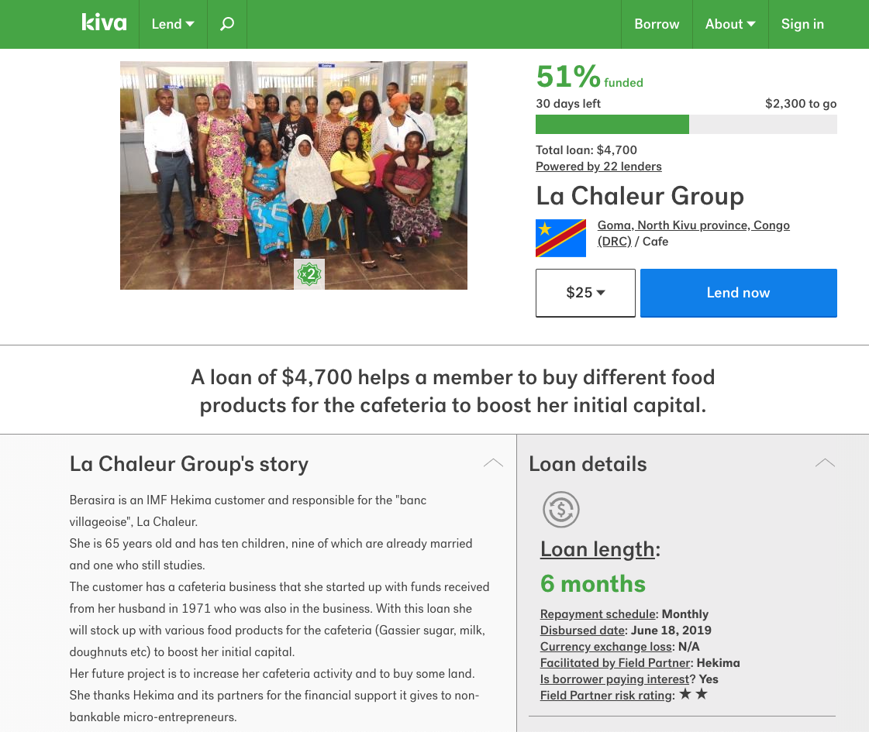
Drive adoption in emerging markets

Slide 22
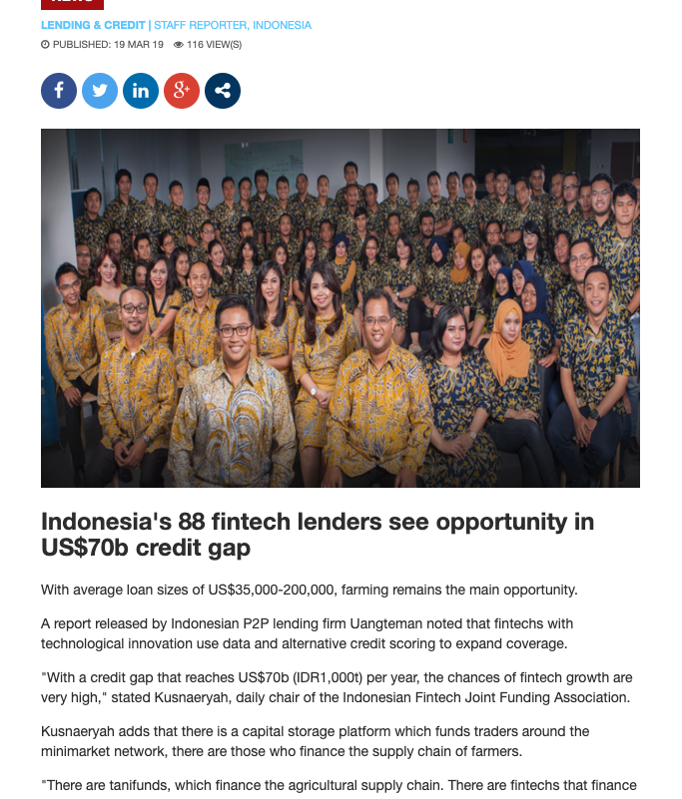
Create organic Dai demand
Payment rail / settlement layer for emerging markets debt capital
Loans with USD-receivables (e.g. FMCG supply chain, clothing)

Slide 23
Strong narrative for regulator approval of Dai usage
Payment rail / settlement layer for emerging markets debt capital

Slide 24
Annex

Slide 25
Peer-to-peer lending

Slide 26
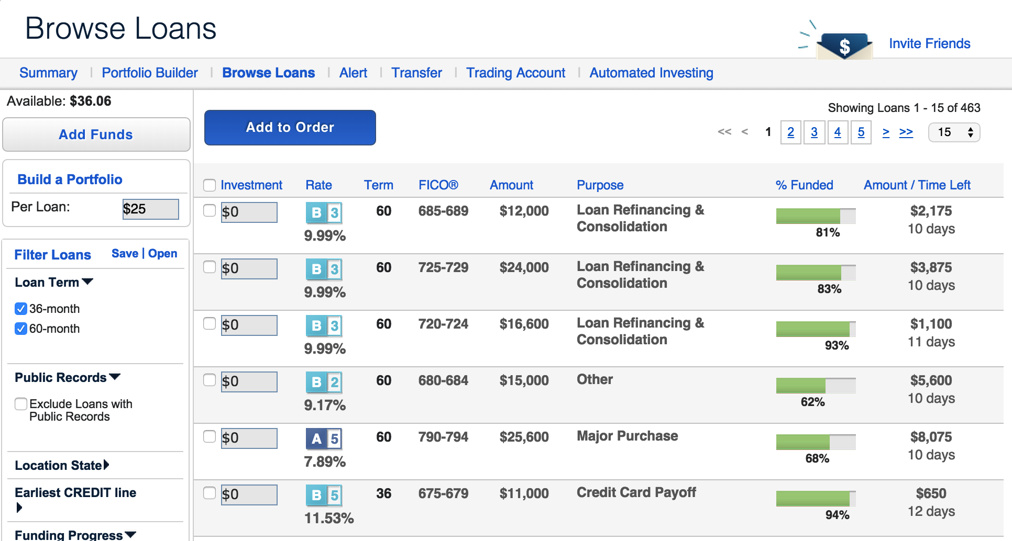
Diversification (vs. high-risk)

Slide 27
Reduced middleman role
3% origination fee, 2% servicing
v.s. 10-15% interest spread at banks

Slide 28
Peer-to-peer lending (cross border)

Slide 29
“Credit is fundamentally broken when crossing borders” Cameron Stevens Founder, Prodigy Finance

Slide 30
Massive credit gaps

Slide 31
Peer-to-peer lending platforms

Slide 32



How traditional P2P lending works (Part I)
I’d like to borrow $1000
Lender A’s Escrow Account
P2P Loan Platform
$100
Ines’ Loan
P2P Platform’s
Escrow Account
Lender B’s Escrow Account
$300
Lender C’s Escrow Account
Lender C’s
US Bank
$600
$600

Slide 33
How traditional P2P lending works (Part 2)
I’d like to borrow $1000
Lender A’s Escrow Account
P2P Loan Platform
$100
Ines’ Loan
P2P Platform’s
Escrow Account
Lender B’s Escrow Account
$300
Lender C’s Escrow Account
Lender C’s
US Bank
$600
$600

Slide 34
Why aren’t you building a marketplace?

Slide 35
Why a stablecoin loan kit Focusing on doing one thing really well
Repayment Cycle
Collections
Loan Origination
Underwriting
Funding
Return to LPs
Possibly too early to market to be venture fundable
Too difficult to address (identity and reputation protocols are in infancy)

Slide 36
Do one thing really well:
Automation of loan logistics through smart contracts. Tech is at readiness level to allow for this
Why a stablecoin loan kit Focusing on doing one thing really well
Open source strategy: let market organically emerge
Repayment Cycle
Collections
Loan Origination
Underwriting
Funding
Return to LPs
Possibly too early to market to be venture fundable
Too difficult to address (identity and reputation protocols are in infancy)

Slide 37
1. Will people lend?
https://github.com/enabledao/enable/issues/74

Slide 38
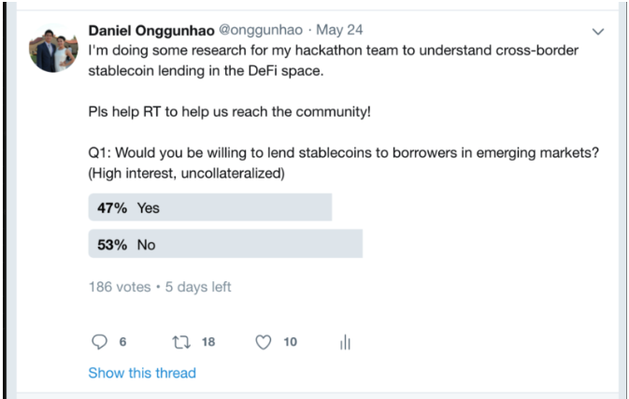

Slide 39
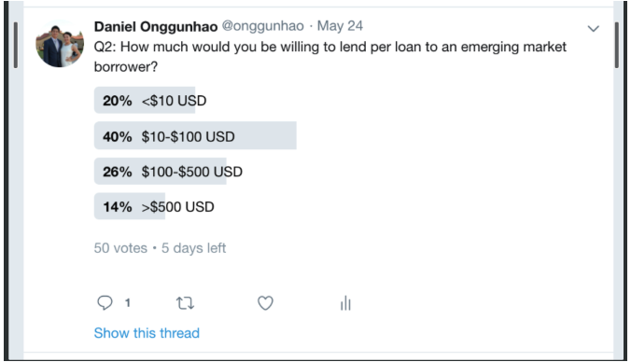
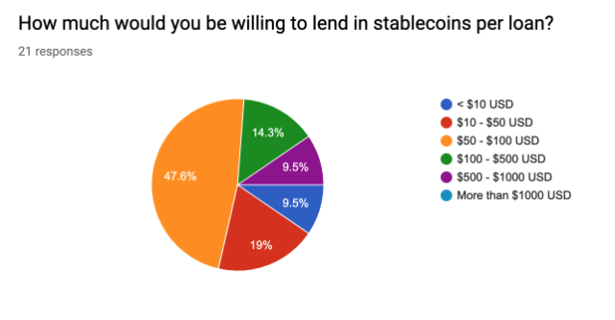

Slide 40
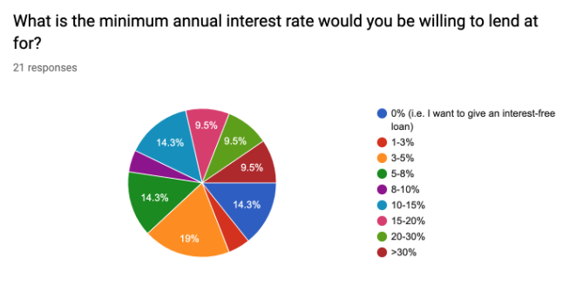

Slide 41
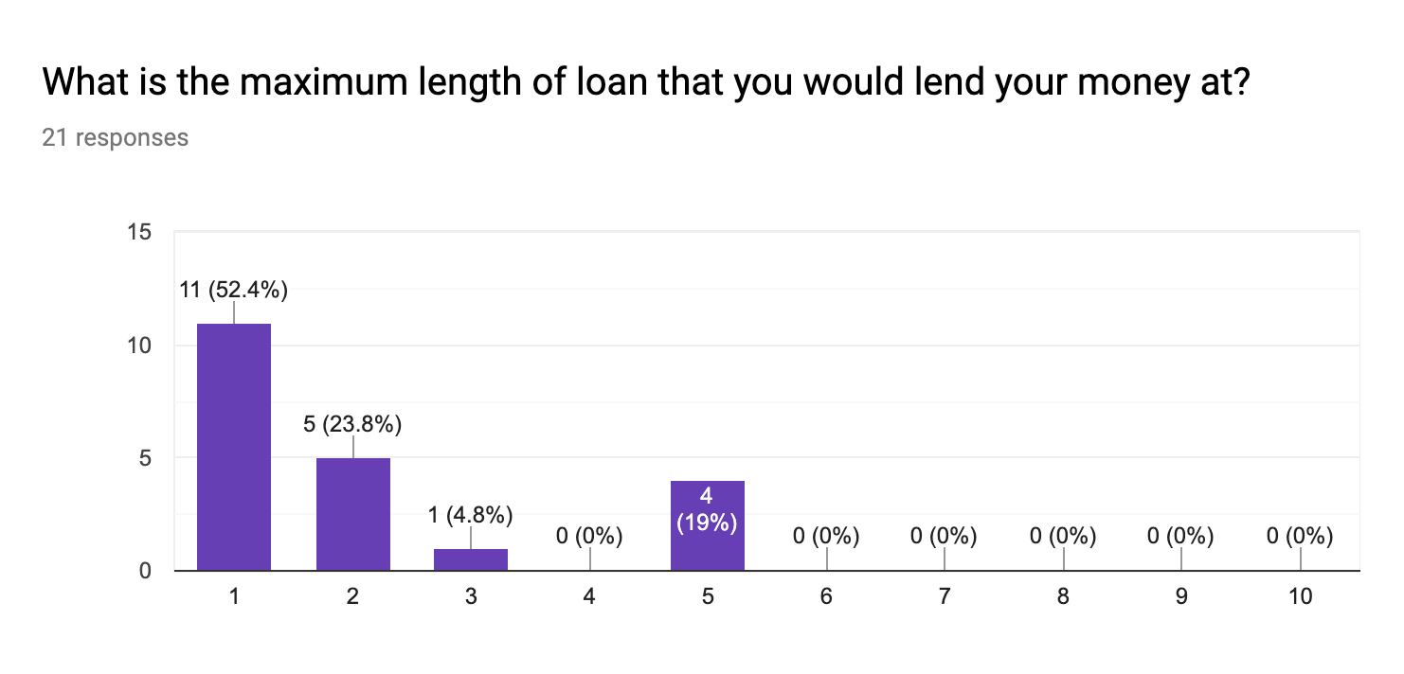

Slide 42
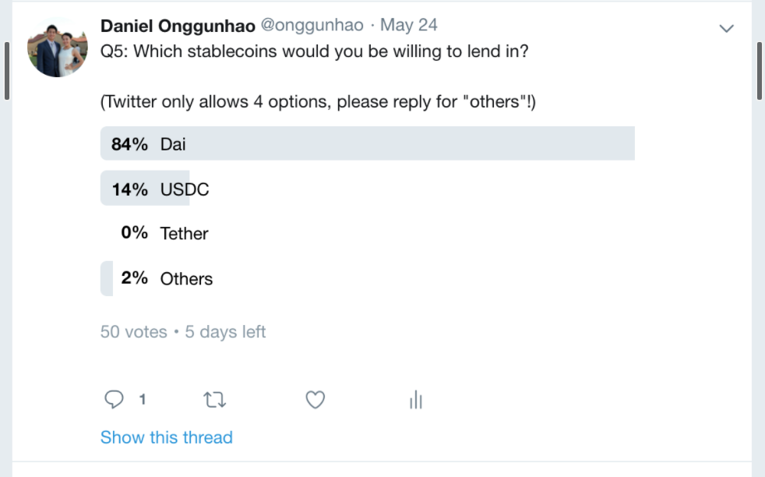
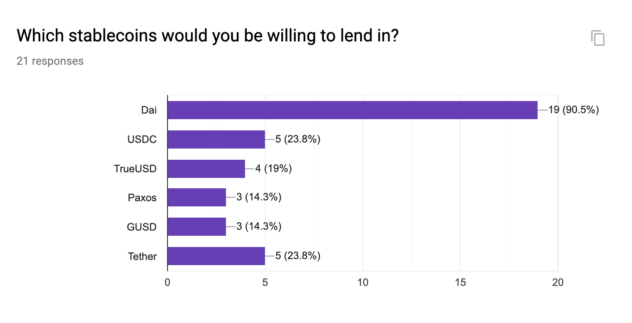

Slide 43
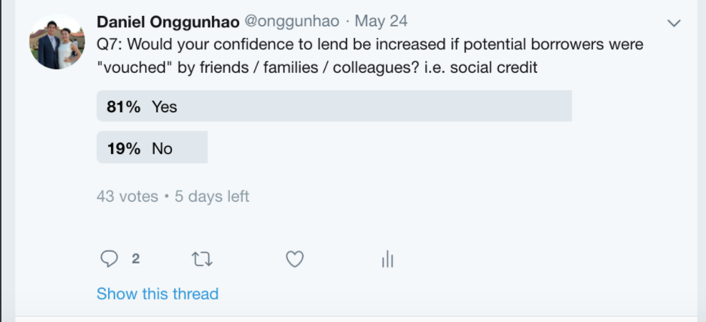
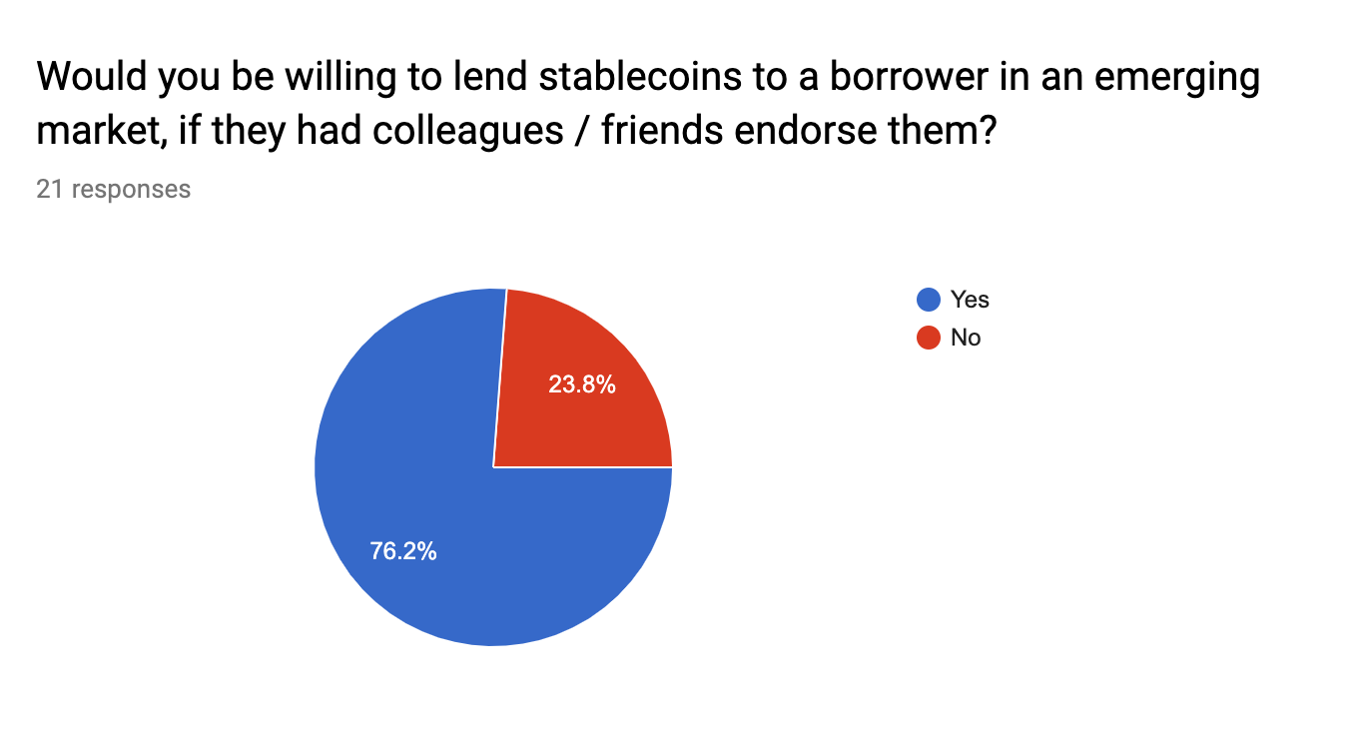

Slide 44
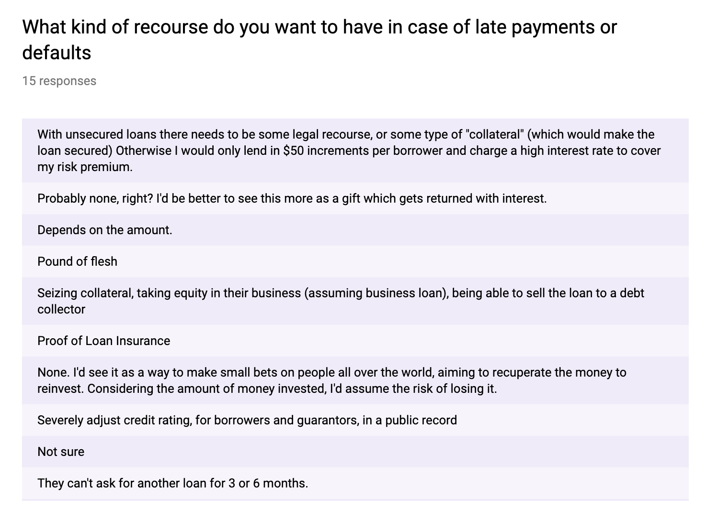

Slide 45
2. Is there a sustainable business model?
https://github.com/enabledao/enable/issues/90

Slide 46
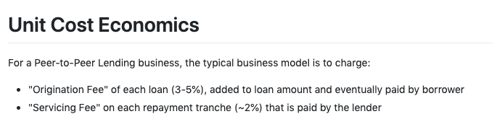
https://github.com/enabledao/enable/issues/90

Slide 47
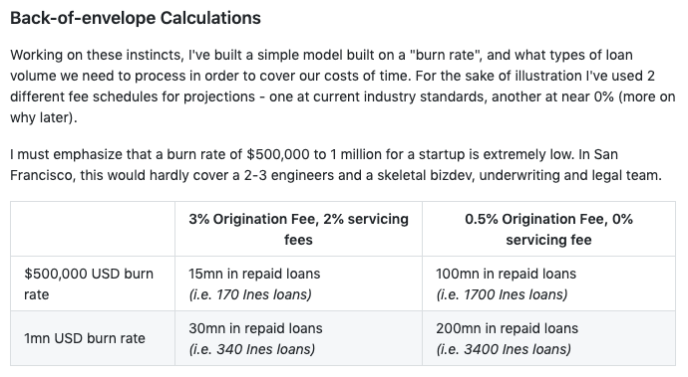
https://github.com/enabledao/enable/issues/90

Slide 48
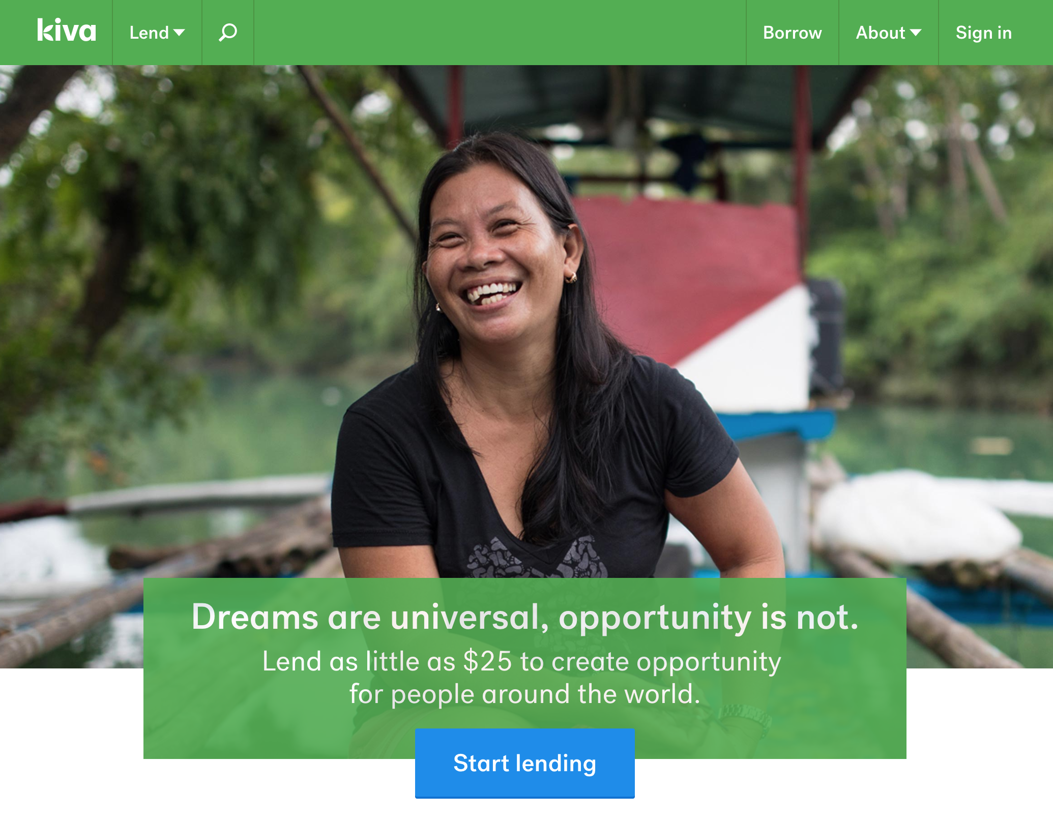
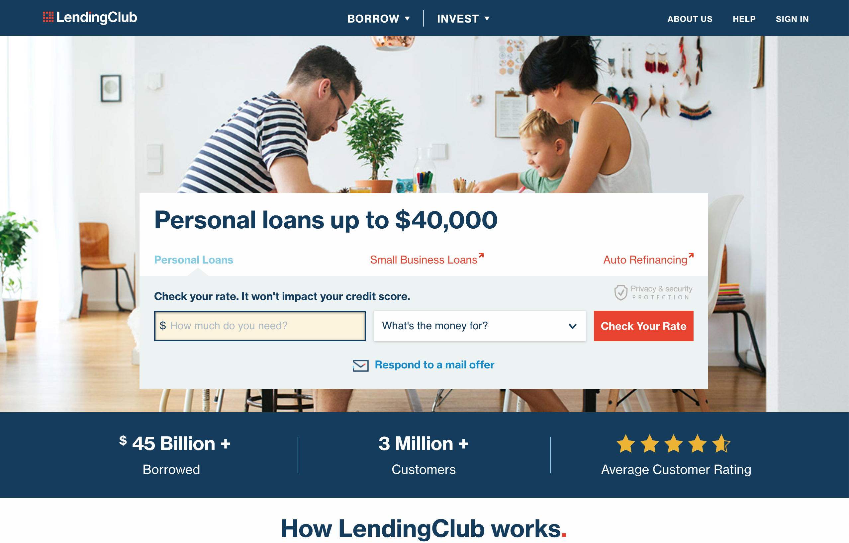
or

Slide 49
Real World Defi: Ines’ journey to Cornell
Follow us:

